Slide 1



Slide 2

Employee performance appraisal management system
Group Members:
Sara Laraib Ali(FA16-BCS-052)
Nida Yaseen (FA16-BCS-048)
Supervised by:
Ma’am Tahira sadaf
Presented on 18 july,2020
Department of Computer Science
COMSATS University Islamabad, Attock Campus

Slide 3
Outline
_______________________________
Introduction
Related Work / Applications
Problem statement
Objectives
Methodology
Modern tools
Project Implementation
Future Work
References
_______________________________

Slide 4
Introduction
_______________________________
This project related to employee evaluation system containing different portals with databases.
We evaluate the performance on the basis of reviews and ratings of clients and owner.
Suggestions/recommendations messages for employees
Messages in order to develop communication between client and developer team.
Owner can create team and assign task to teams .
Manager add task in assigned projects
Employee add activity in assigned task of project.
Client and owner can rate and give reviews after project completion.
_______________________________

Slide 5
Related Work
_______________________________
Many android app’s like Whtsapp,googlemaps,instgram etc are evaluated on play store through rating and reviews from user.it help the developer to check how his app is working and what are more feature he should add in app according to user demand.
Websites like word press are evaluated through rating and comments from client’s or users.
_______________________________

Slide 6
Problem Statement
_______________________________
In order to solve the problem of manually tracking the company progress and evaluating employees performance we are developing web based portal for employee evaluation and checking the company progress.
In previous system project assigned to team through meetings and create team through meeting and discussion we are developing web portal system , so owner can manage task and team easily.
There is no web based system exist which rates the employee and provide suggestions/recommendations on the basis of rating.
_______________________________

Slide 7
Objectives
_______________________________
Web portal allow the owner to keep the track of company progress.
Owner able to view employee performance and can see client reviews about his/her company employee’s.
Owner can create best team for upcoming projects.
Client and owner both can add projects.
Manager can assign task to under-his/her supervision employee.
Employee can check ratings in his/her own portal.
Employee can communicate with manager only.
Client can communicate with manager.
Owner can communicate with manager and owner.
_______________________________

Slide 8
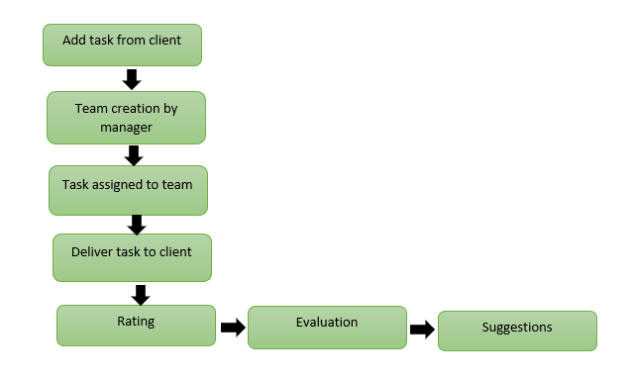
Methodology
_______________________________
We are using software process methodology.
_______________________________

Slide 9
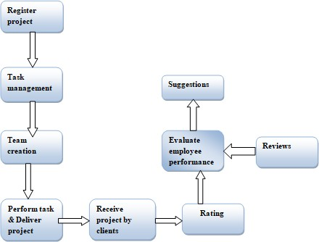
Architecture Diagram
_______________________________
_______________________________

Slide 10
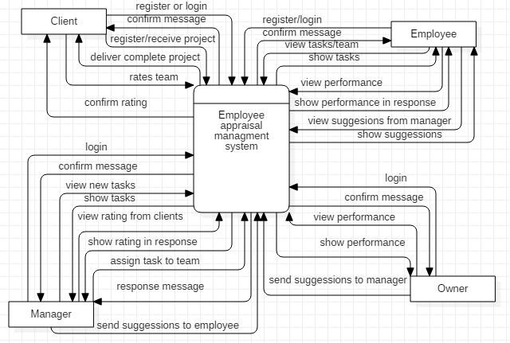
Data Flow Diagram
_______________________________
DFD Level 0
_____ _DFD level 0_______________

Slide 11
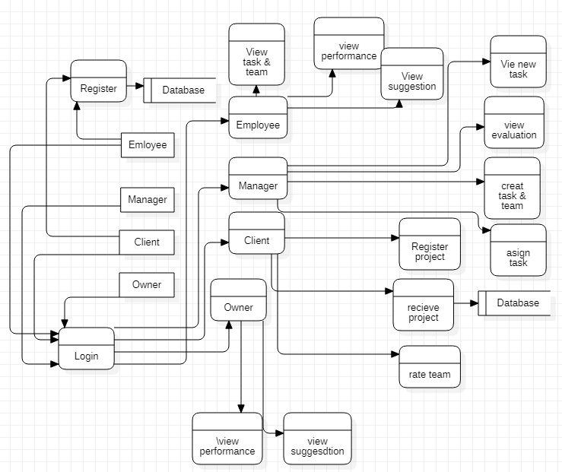
Data Flow Diagram
_______________________________
_______________________________
DFD Level 1

Slide 12
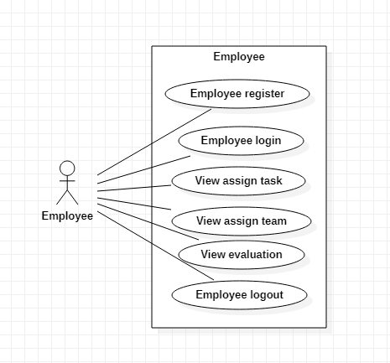
Use Case Diagram
_______________________________
_______________________________
Employee Use Case diagram

Slide 13
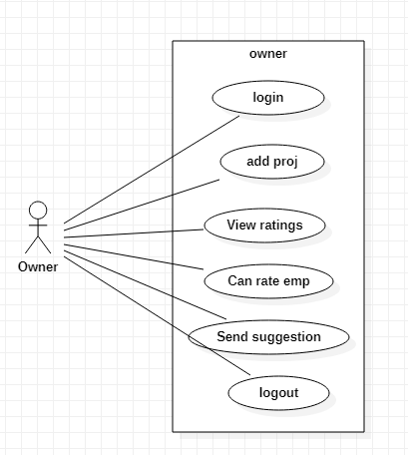
Use Case Diagram
_______________________________
_______________________________
Owner Use Case diagram

Slide 14
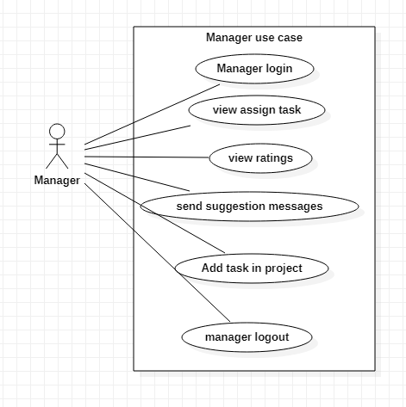
Use Case Diagram
_______________________________
_______________________________
Manager Use Case diagram

Slide 15
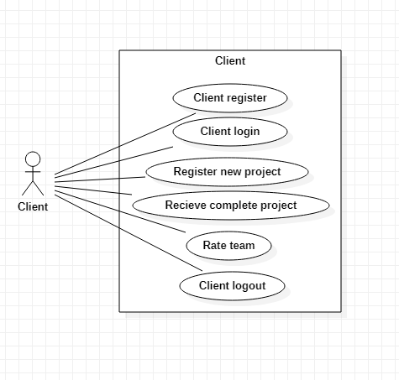
Use Case Diagram
_______________________________
_______________________________
Client Use Case diagram

Slide 16
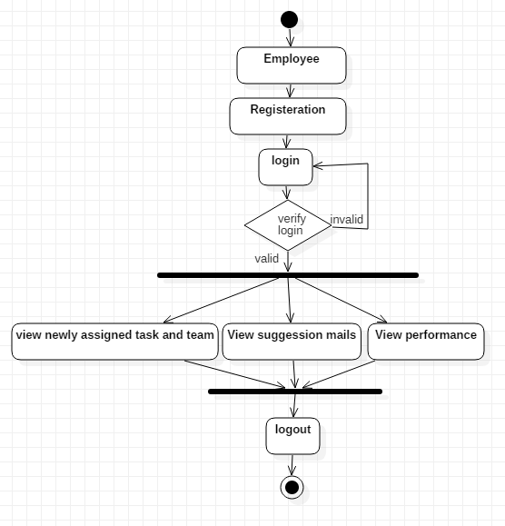
Activity Diagram
_______________________________
_______________________________
Employee Activity Diagram

Slide 17
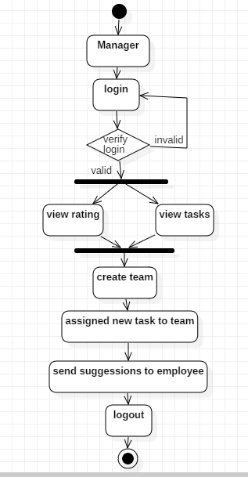
Activity Diagram
_______________________________
_______________________________
Manager Activity Diagram

Slide 18
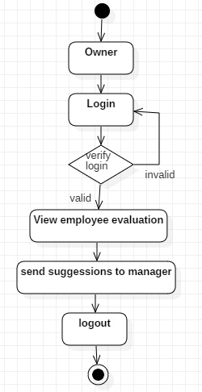
Activity Diagram
_______________________________
_______________________________
Owner Activity Diagram

Slide 19
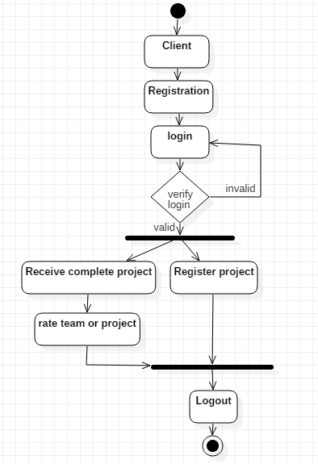
Activity Diagram
_______________________________
_______________________________
Client Activity Diagram

Slide 20
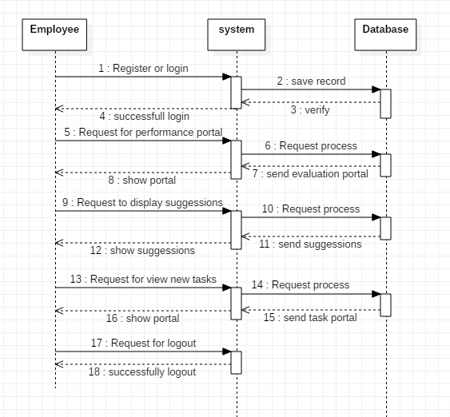
Sequence Diagram
_______________________________
_______________________________
Employee Sequence Diagram

Slide 21
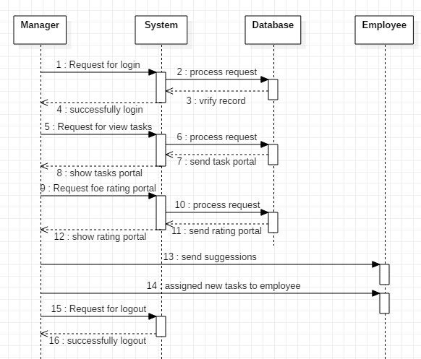
Sequence Diagram
_______________________________
_______________________________
Manager Sequence Diagram

Slide 22
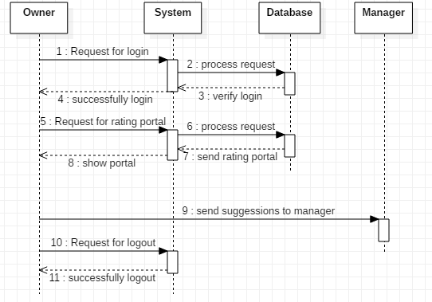
Sequence Diagram
_______________________________
_______________________________
Owner Sequence Diagram

Slide 23
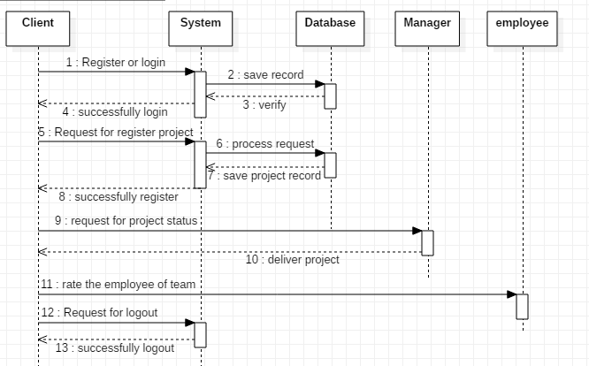
Sequence Diagram
_______________________________
_______________________________
Client Sequence Diagram

Slide 24
Modern Tools
_______________________________
Technologies:
Tools:
MS visual studio
Html.css
Asp.net c#
SQL management server
Star UML
MS word
Power point
Modern Tools
_______________________________

Slide 25
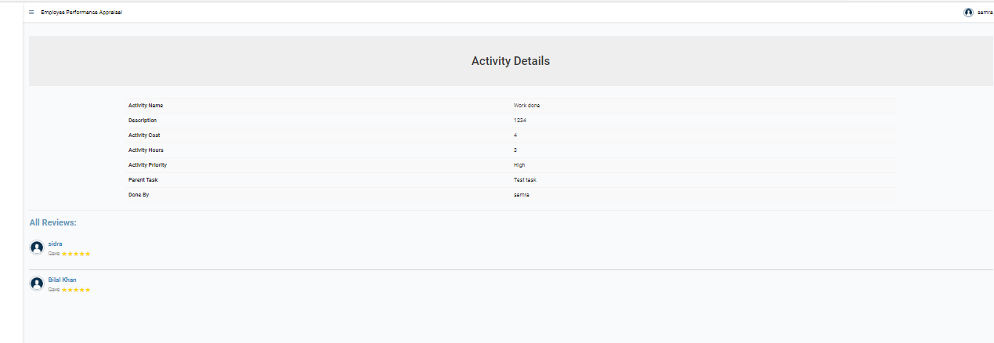
Rating and reviews
_______________________________

Slide 26
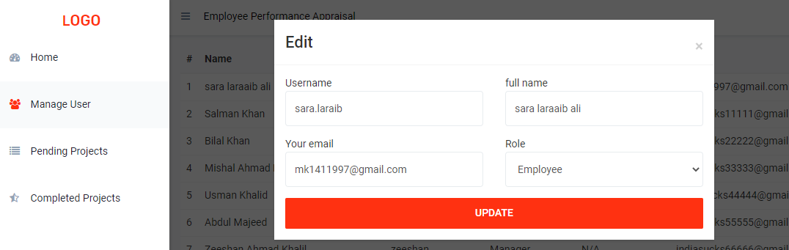
Role edit by owner:
_______________________________

Slide 27
API’S
Google charts:
Google charts is JS based. It is used to show the progress that how much work is completed and show work priority etc.
SMTP for mails:
SMTP is used to send messages from end to end users. It used to send the message and to established communication between users of website.
_______________________________

Slide 28
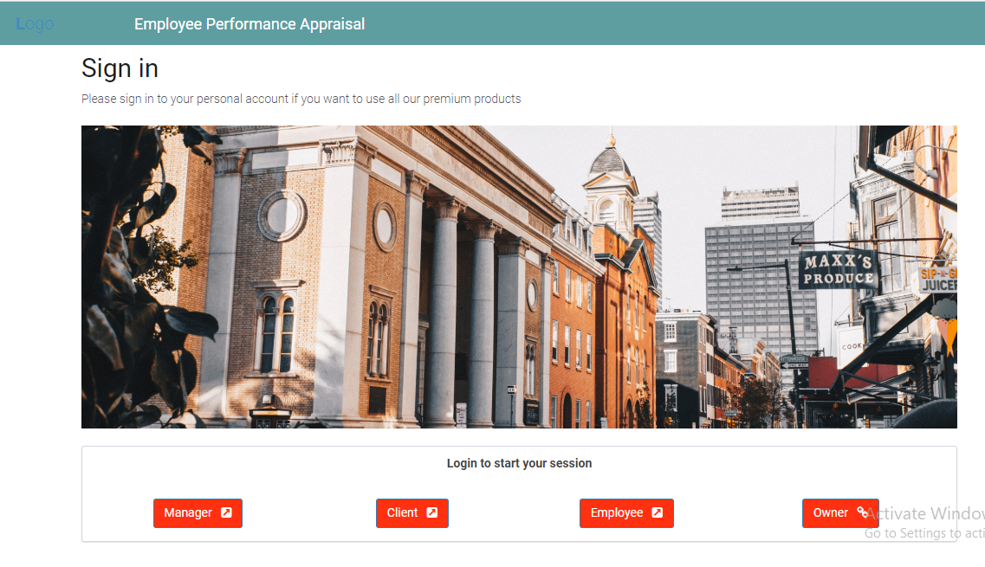
Main interface
_______________________________

Slide 29
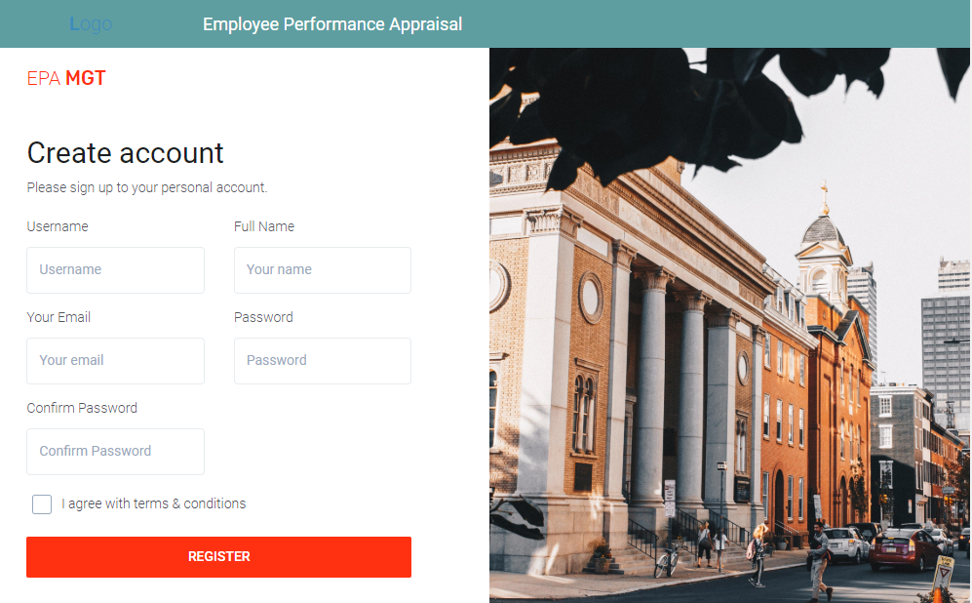
Sign-up interface
_______________________________

Slide 30
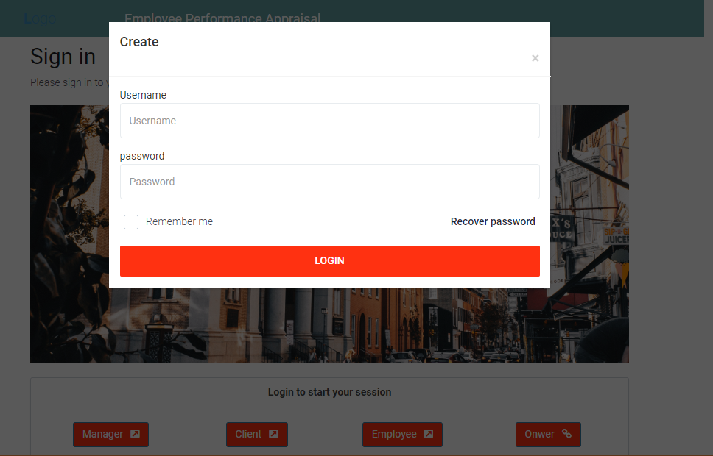
Login interface
_______________________________

Slide 31
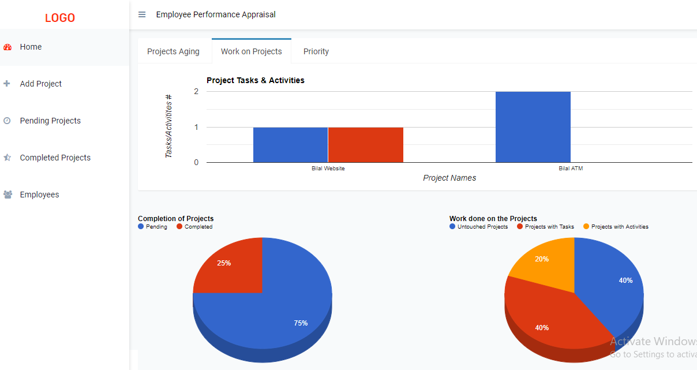
Client interface
_______________________________

Slide 32
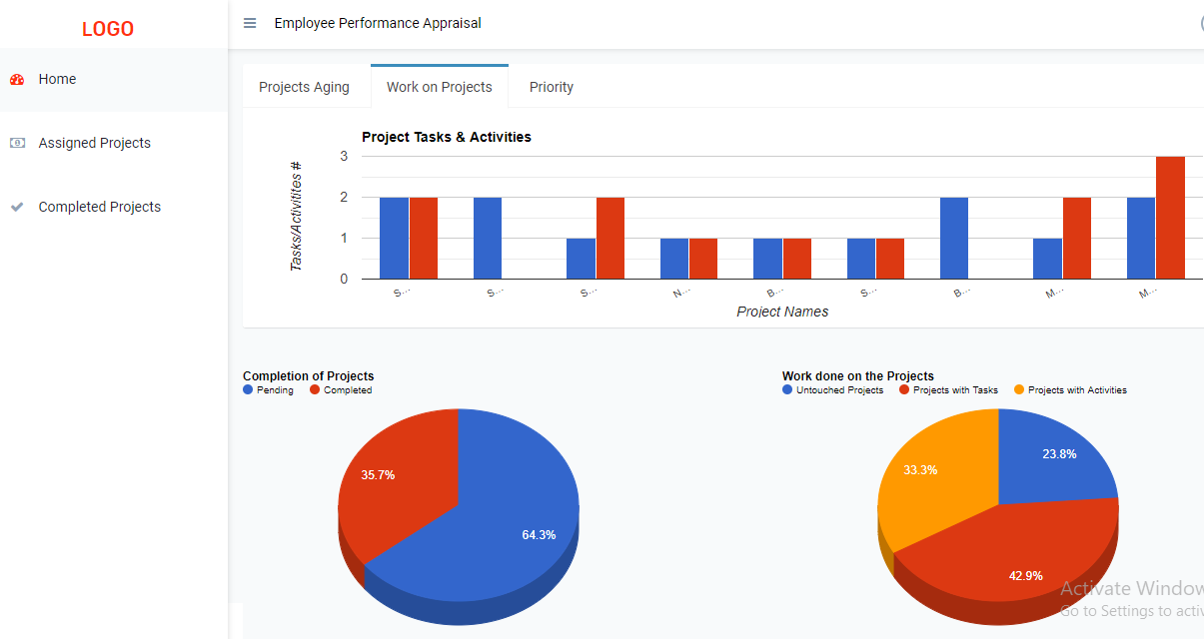
Manager interface
_______________________________

Slide 33
Employee interface
_______________________________

Slide 34
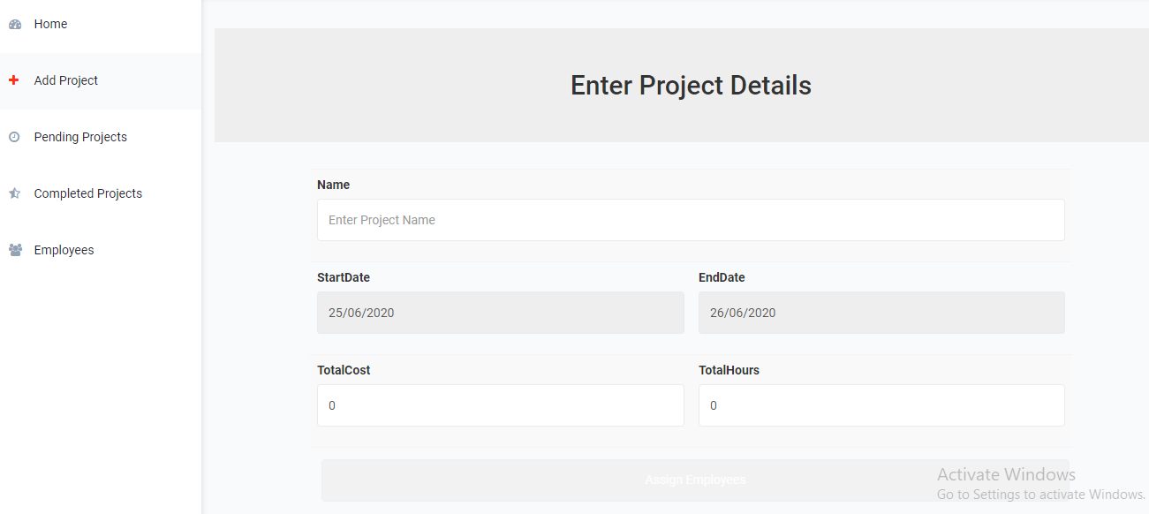
Add project interface
_______________________________

Slide 35
Future Work
_______________________________
Performance evaluation on the basis of client’s rating done in this web-based portal.
In future Selection of team can be done on the basis of project expenses. In future expenses portal can be added which can manage all the expenses of company and security for this expenses portal can also be added. A portal can also be added to keep track of completed projects for evaluation of company performance.
_______________________________

Slide 36
References:
https://www.androidpit.com/whatsapps-5-star-rating-problem
https://eternitymarketing.com/blog/how-to-rank-in-the-3-pack-of-google-maps-and-easily-land- clients
http://ir.nust.edu.gh/bitstream/123456789/7664/1/SUALIHU%2C%20BIINTU. https://www.tripwiremagazine.com/wordpress-rating-plugins/ https://www.smartdraw.com/use-case-diagram/ https://www.stickyminds.com/article/state-transition-diagrams
https://docs.microsoft.com/enus/dotnet/api/system.net.mail.smtpclient?view=netcore-3.1
http://csharp.net-informations.com/communications/csharp-smtp-mail.htm
_______________________________

